Slide 1
目录
分布式系统架构范式
Slider介绍
Myriad介绍

Slide 2

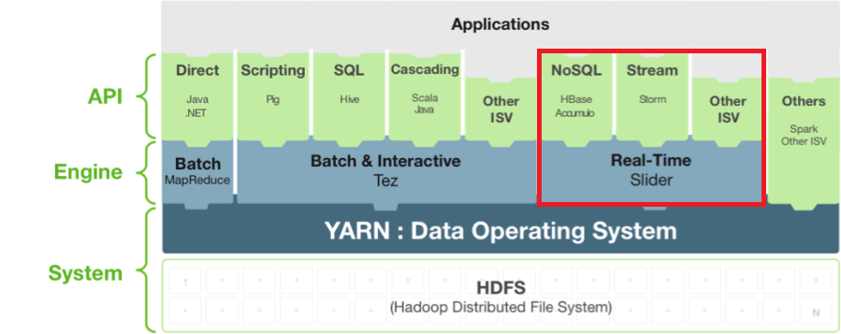
Apache Slider
A Framework for YARN-based, Long-running Applications In Hadoop . Slider “slides” these long-running services, so that they have enough resources to handle changing amounts of data, without tying up more processing resources than they need.
http://zh.hortonworks.com/apache/slider/
Notes:
batch layer：不可变数据
serving layer：加索引，转成即席查询

Slide 3
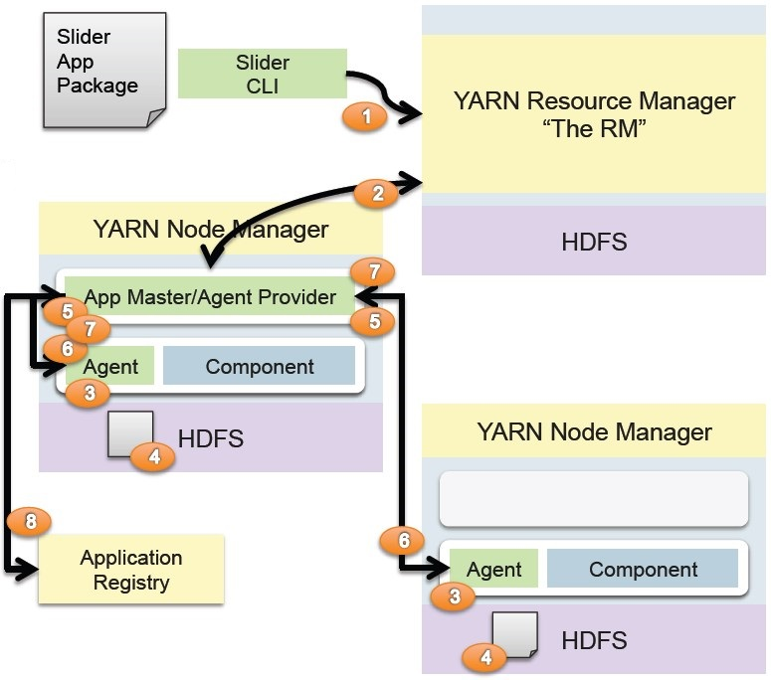
Application by Slider
1.客户端通过CLI启动AM
2.AM向RM请求Container
3.Container被激活，并启动 Slider Agent
4.Agent获取应用程序的描述文件
5.Agent向AM注册
6.AM向Agent发送应用程序启动等命令
7.Agent汇报状态，配置等
8.AM注册服务地址，配置等
当前已经支持的应用包括Tomcat,HBase,Storm,Accululo,Kafka,
Jstorm,Memcached,Solr等
Notes:
batch layer：不可变数据
serving layer：加索引，转成即席查询

Slide 4
Coming up
YARN-5079: Natvie YARN Framework layer for services and beyond
将Apache Slider并入YARN，作为YARN-Native-Service
YARN-5538：Supporting a compisite app-of-apps

Slide 5
谢谢！

